Slide 1
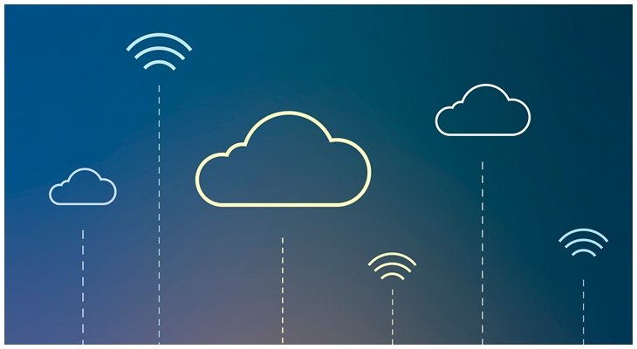
KV Storage for Edge and Regionless Cloud
Ke Xu, Peng Du

Slide 2

Definitions
Edge:
Data centers
Network:
Dedicated line
Unreliable connection
Network partition (failure) could still happen
$$m+N$$

Slide 3
User Cases
”Globally available” Storage
Set, Hashmap, (think Redis)
Message queue (sorted set)
…

Slide 4
Requirements/POC fous
Availability
Consistency Model
Quorum
Strong Eventual Consistency (CRDT)
Querying Model
K → V, read (put), write(get)
ACID Properties
Efficiency
R2
request
R1
R3

Slide 5
Other Consideration (Possibly out of POC scope)
Load balancing, membership
Failure detection & failure recovery
Replica synchronization, Overload handling
Request marshalling & routing
System monitoring and alarming
Configuration management

Slide 6
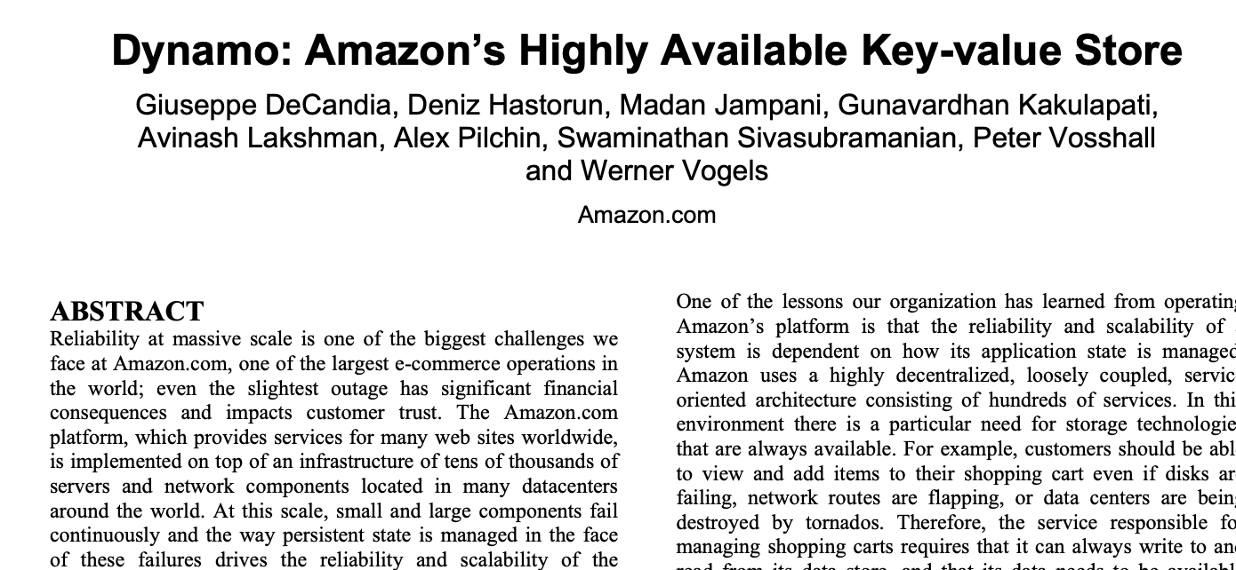
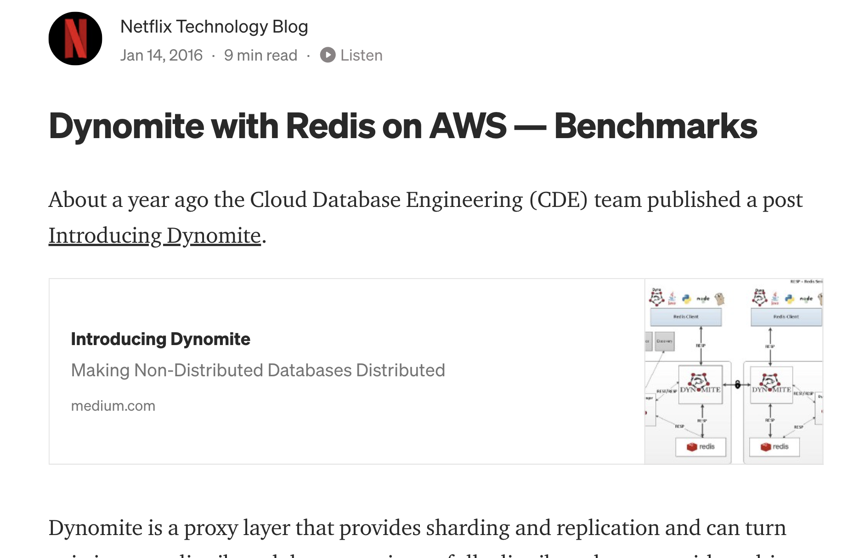
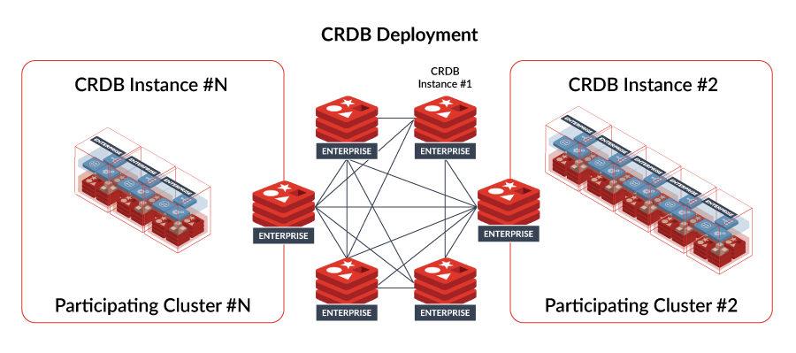
KV Reference Solutions
AWS Dynamo (white paper)
Dynamite (Netflix)
Redis Active-active

Slide 7
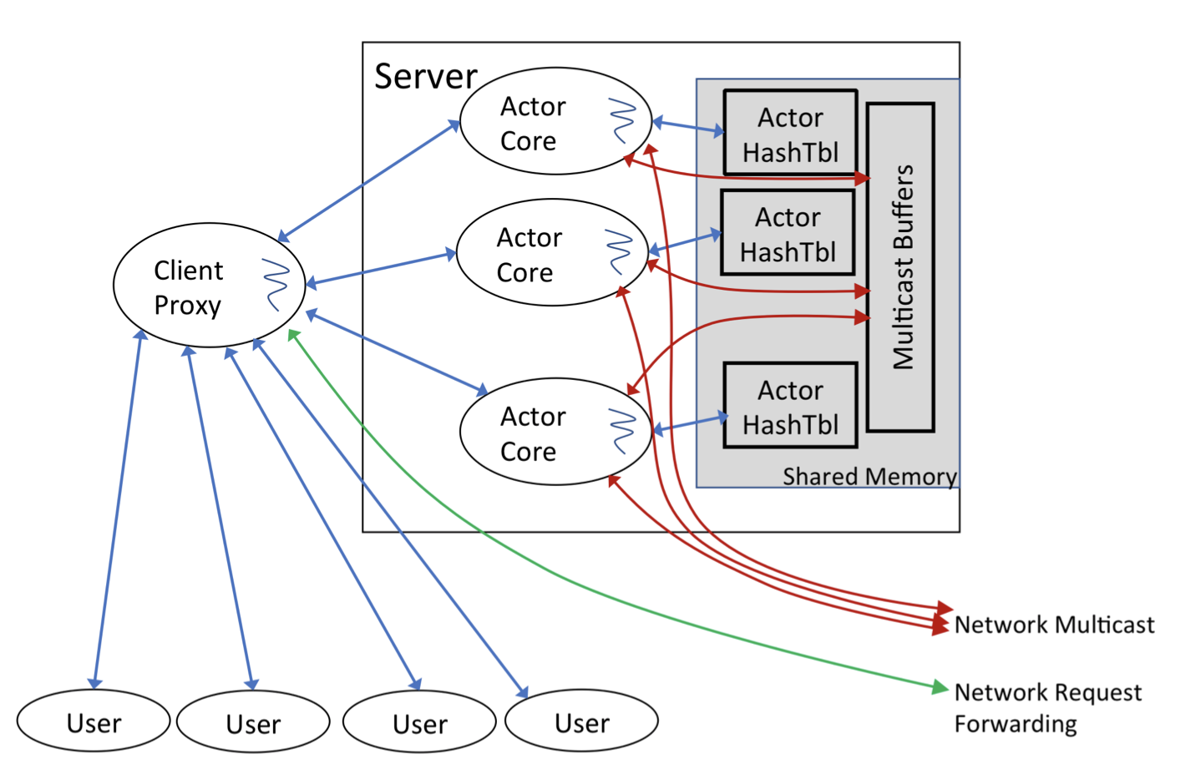
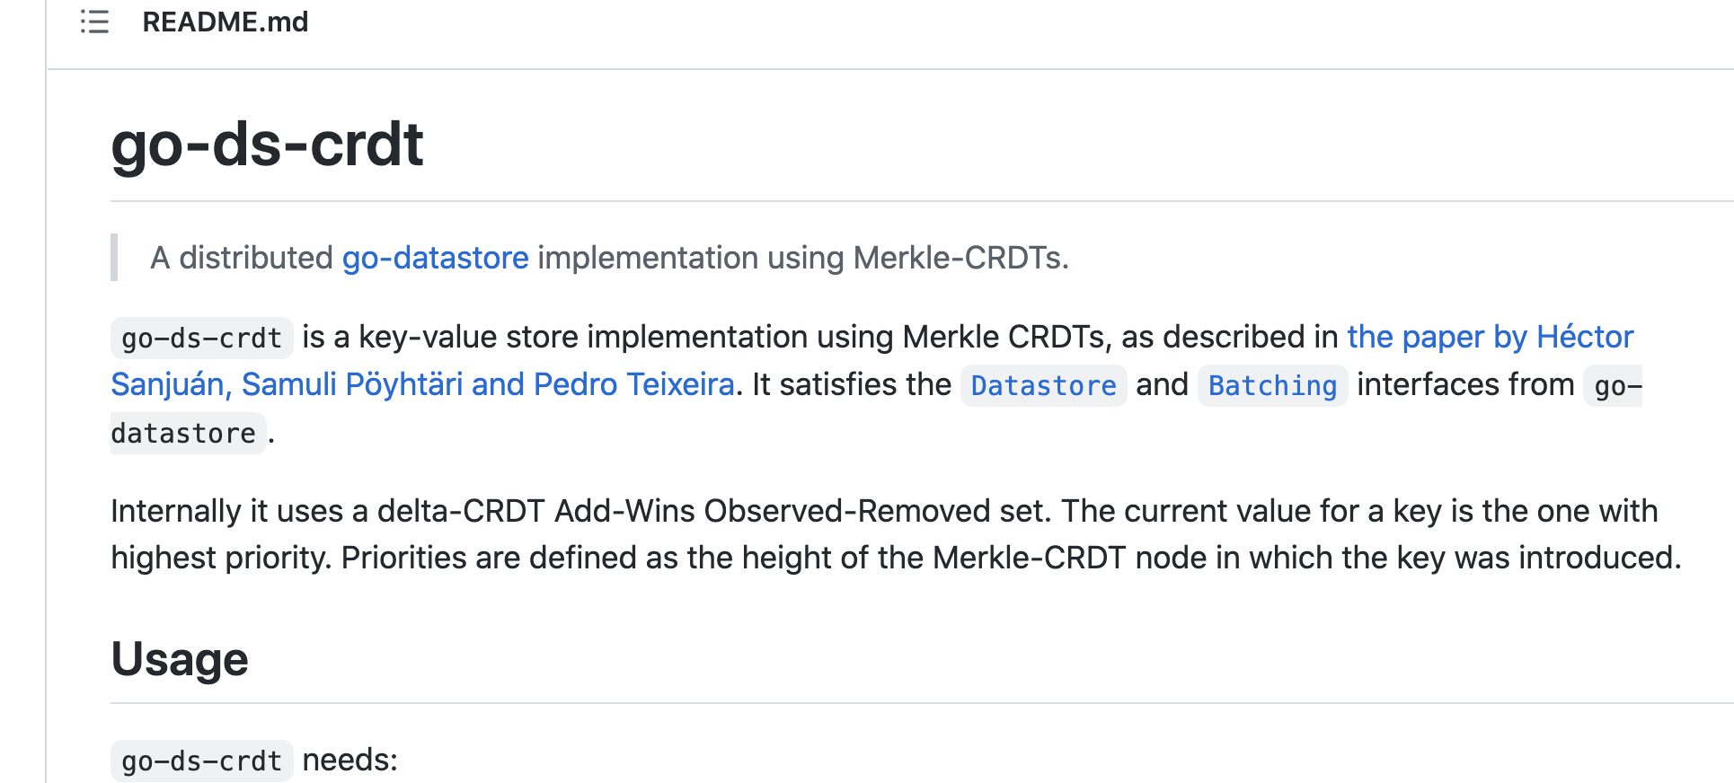
CRDT References
Anna → CRDT implementation
go-ds-crdt (“logical” Merkle clock)

Slide 8
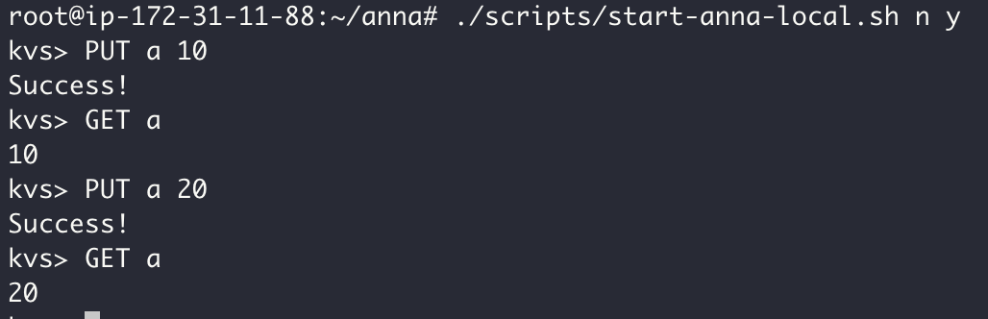

Distributed K-V store
K1, V1
K2, V2
…
K_{n}, V_{n}
K1, V1
K2, V2
…
K_{n}, V_{n}
$$k,v$$
K1, V1
K2, V2
…
K_{x}, V_{x}

Slide 9
K1, V1
K2, V2
…
K_{n}, V_{n}
K1, V1
K2, V2
…
K_{n}, V_{n}
K1, V1
K2, V2
…
K_{n}, V_{n}
K1, V1
K2, V2
…
K_{n}, V_{n}
Simultaneous READs & WRITES
Unreliable connection between region/edge DC
Inconsistent and possibly Limited resources (CPU, memory, RDMA, network speed, etc.)

Slide 10
_{Hash Ring}
K1, V1
K2, V2
…
K_{n}, V_{n}
K_{n+1}, V_{n+1}
K_{n+2}, V_{n+2}
…
K_{n+k}, V_{n+k}
K_{n+k+1}, V_{n+k+1}
K_{n+k+2}, V_{n+k+2}
…
K_{n+k+x}, V_{n+k+x}
CRDT
CRDT
CRDT
Consistency Hashing → Key partition
Geo-region aware
Multiple replica → Availability
”Global distributed” → Edge cross-cluster communication

Slide 11
Discussion on Edge Storage Architecture
Option #1 Full Replica on All Nodes
Option #2 Sharded Replica
API/CLI
API/CLI
Key Value Store
Key Value Store
CRDT
DHT Ring
Causal Knowledge Base
(DAG Based)
Merge Function
Key Lifecycle Management
Partitioning Algorithm
Data Versioning
Ring Routing Algorithm
CRDT on replicas
Communication
Communication
Direct e2e
P2P
Direct e2e
P2P
Every node keeps a full replica
New CRDT math model is under development
Every node keeps a sharded replica
A common sharded replica is available on multiple nodes, synced by CRDT
Notes:
Replica on all nodes? Volume, node#
Routing (1) full (2) optimized

